Slide 1

"Netflix Stock Profile"
In finance, a stock profile is a series of studies, visualizations, and analyses that dive into different aspects a publicly traded company's data.

Slide 2
For the purposes of the project, you will only visualize data for the year of 2017. You will can see following visualizations:
The distribution of the stock prices for the 2017.
Netflix's earnings and revenue in the four quarters of 2017.
The actual vs. estimated earnings per share for the four quarters in 2017.
A comparison of the Netflix Stock price vs the Dow Jones Industrial Average price in 2017.

Slide 3
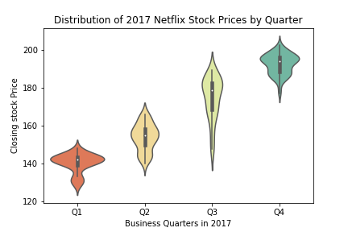
Visualizing the Netflix quarterly data.
Stock prices rise quarter by quarter throughout 2017.
Stock prices during this year had a low of 120 and a high of 200.
The first quarter is the quarter with the greatest variability.

Slide 4
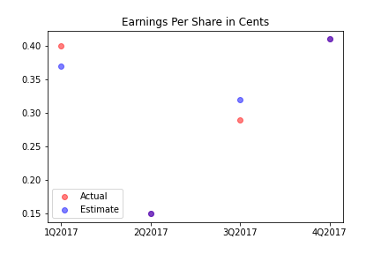
Earnings per share (EPS).
Below, on the scatter plot, we'll plot EPS performance by plotting the estimate Yahoo projected for the quarter versus actual earnings for those quarters.
In the first quarter profits were higher than projected, in the second they coincided, in the third quarter profits were lower than projected, and in the fourth they coincided again.

Slide 5
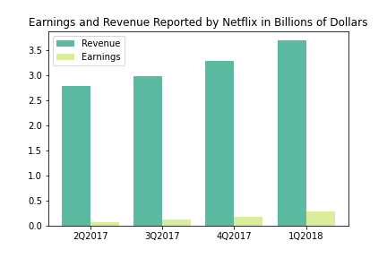
Earnings and revenue reported by Netflix.
Revenues and earnings are trending upwards during the year 2017.
Earnings relative to revenues are approximately 5%.

Slide 6
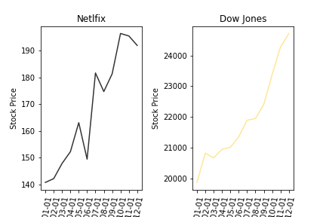
Compare Netflix stock to the Dow Jones Industrial Average in 2017
Nexflix outperformed Down Jones, growing about twice as fast in 2017.
Nexflix is much more volatile, it showed a significant drop in June and a very fast growth in July.

